Slide 1



Beekeeper Studio
Installation

Slide 2
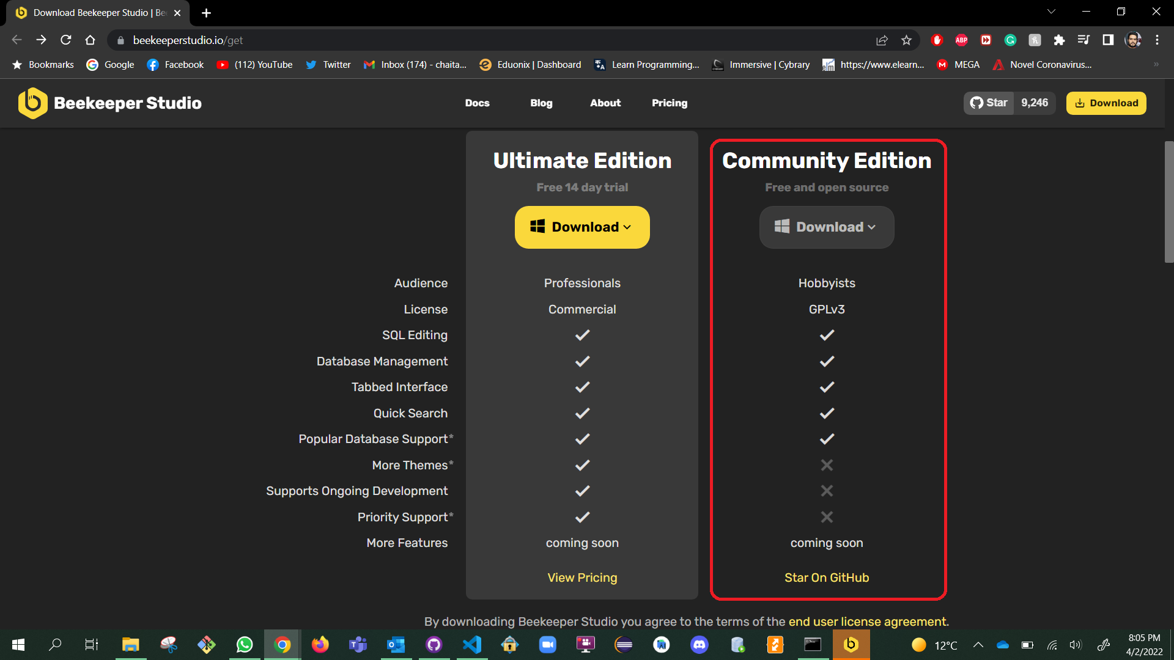


Steps
Link to download:- https://www.beekeeperstudio.io/get
Select the Community Edition.

Slide 3
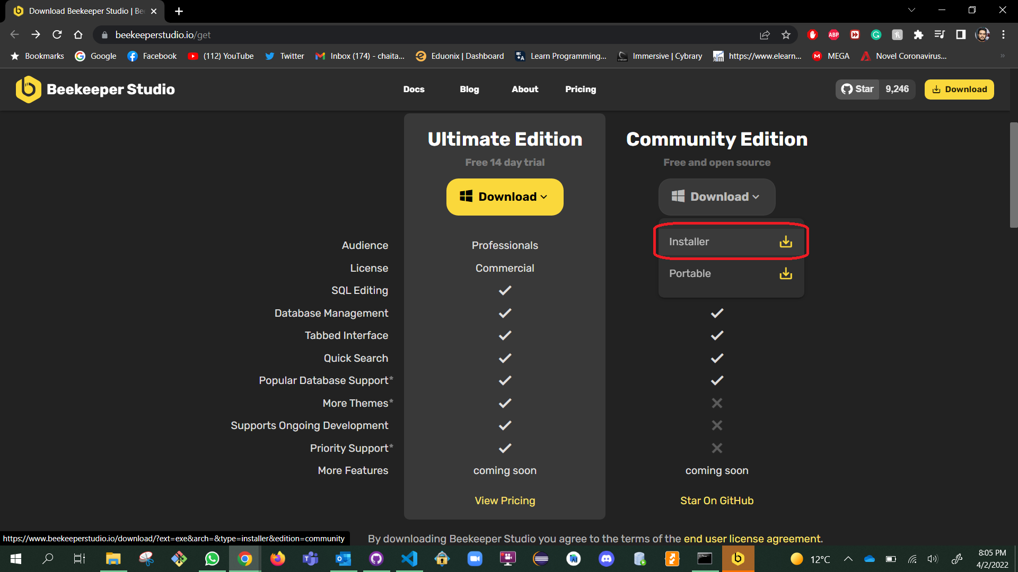
After Clicking on Download choose “Installer” edition

Slide 4
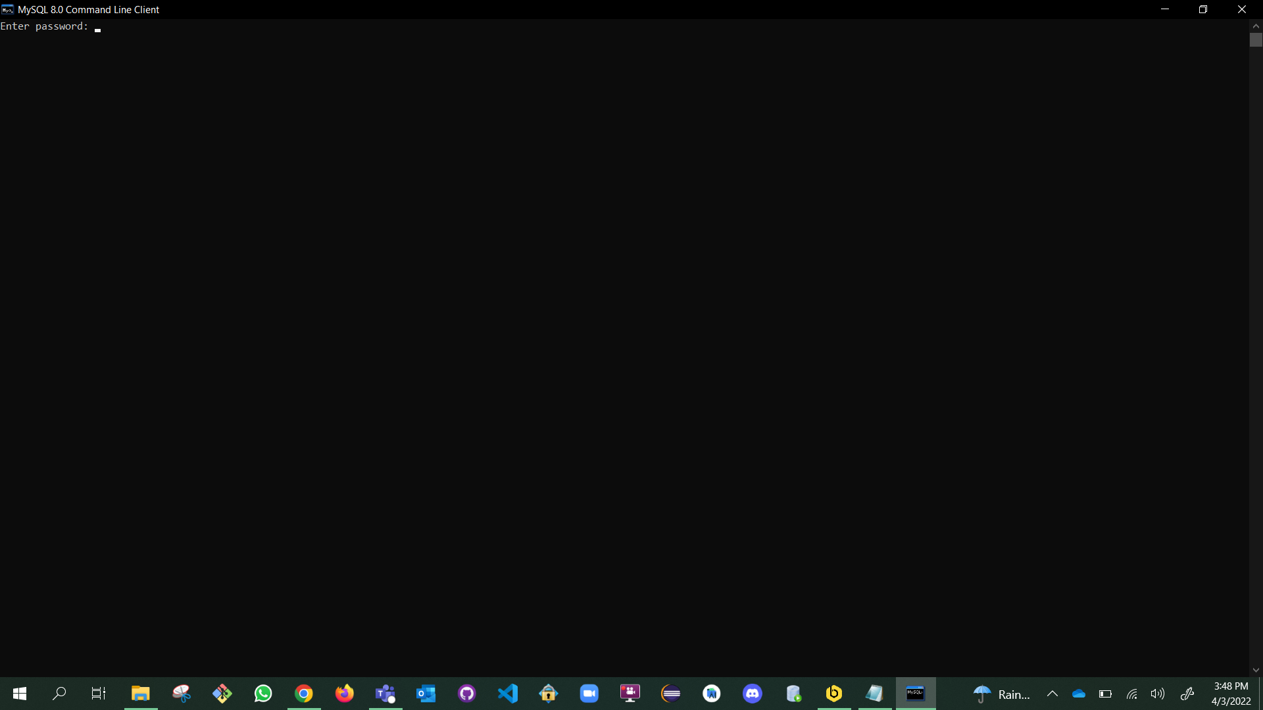
Open MySQL 8.0 Command Line Client & click Enter.

Slide 5
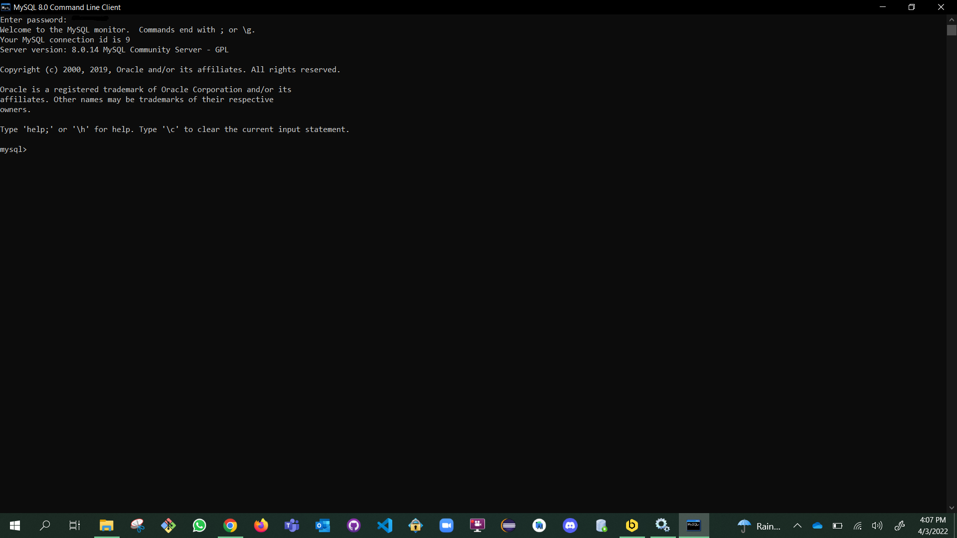
After Clicking on Enter it shows the command prompt as shown here.

Slide 6
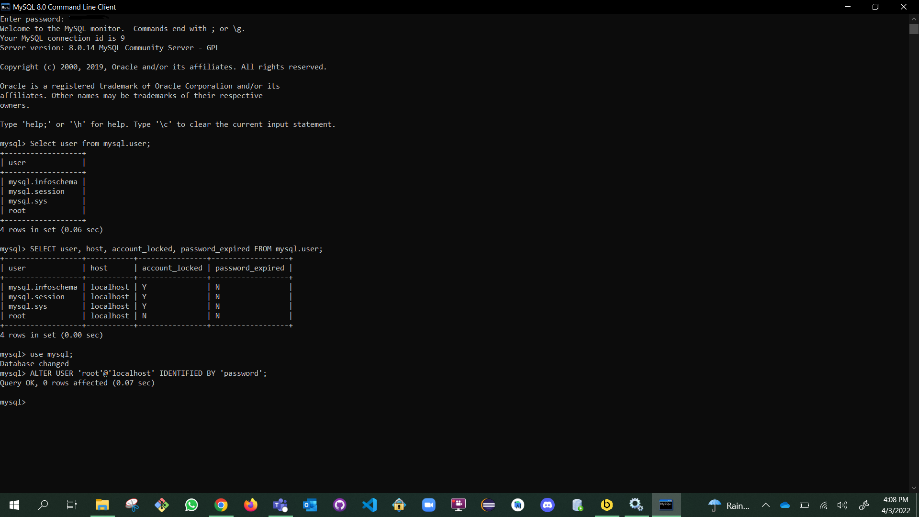
Enter the Commands step by step.
Select user from mysql.user;
SELECT user, host, account_locked, password_expired FROM mysql.user;
use mysql;
ALTER USER 'root'@'localhost' IDENTIFIED BY 'password’;

Slide 7
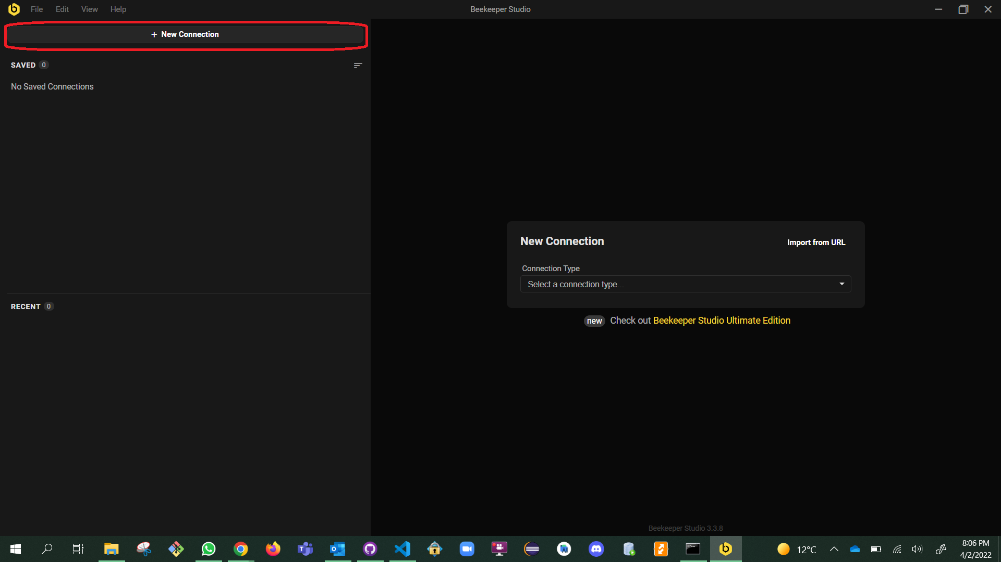
Open the “Beekeeper Studio” and click on New Connection.

Slide 8
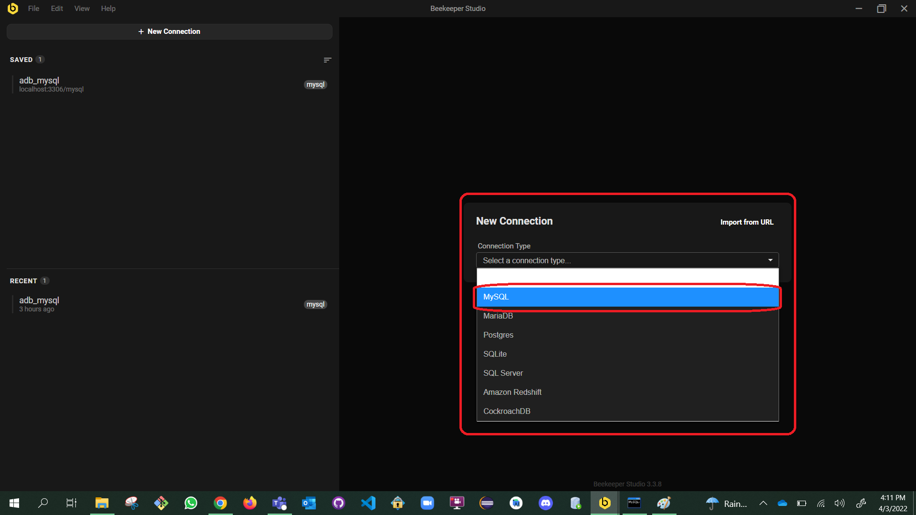
Click on the dropdown so that you can see many Connection Types, in which we choose “MySQL”.

Slide 9
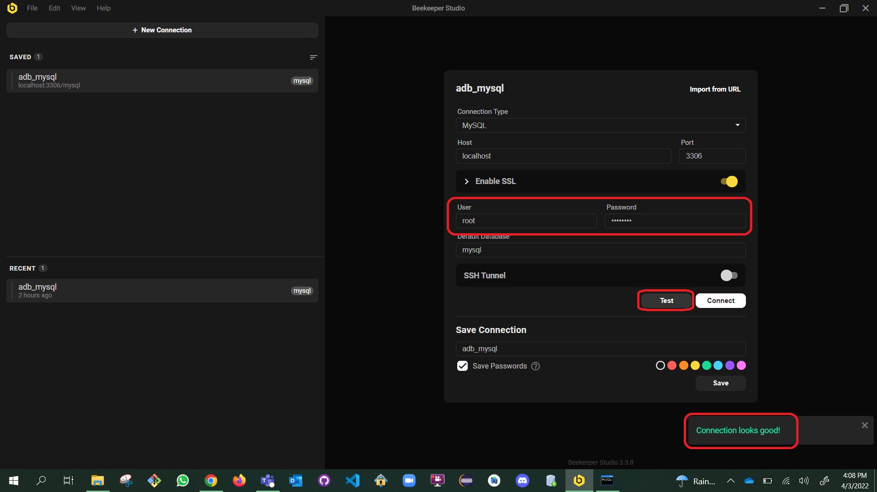
“Enable SSL”
Set the User as “root” & Password as “password”
Default Database as “mysql”
Save Connection as “adb_mysql”
\ and click on the Test so that you can see a pop stating “Connection looks good!”
\ and click on connect.

Slide 10
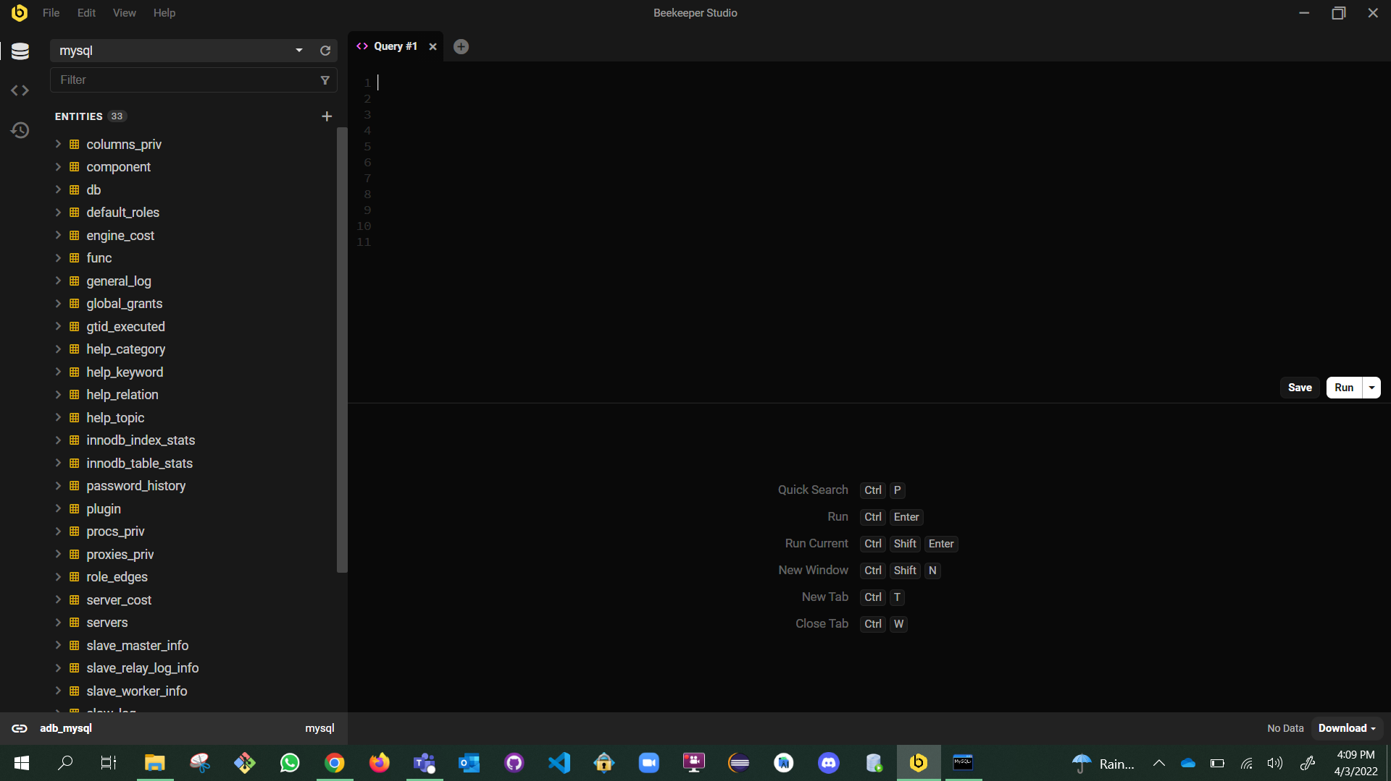
When you click on “Connect” you will see a Blank “Query window”.

Slide 11
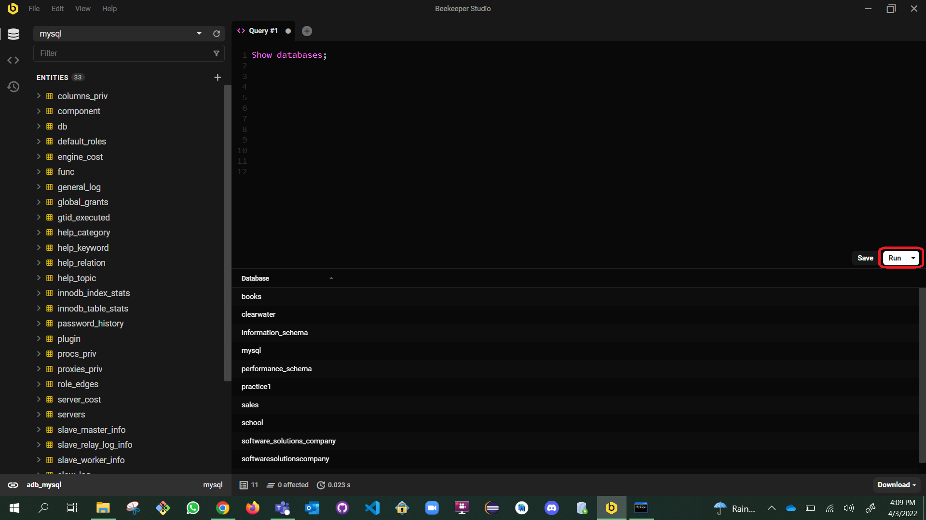
We can start by typing Queries & click on the “Run” button which is on right most middle of the window.
The Output can be seen below.

Slide 12
The End
Thank you!

